Slide 1
Computer Security final Exam
Hansel Ricardo – Course-Net

Slide 2
Configuration
01
Konfigurasi kali linux dan Ubuntu

Slide 3
Configuration
02
Konfigurasi kali linux dan Ubuntu

Slide 4
—Someone Famous
“This is a quote, words full of wisdom that someone important said and can make the reader get inspired.”

Slide 5
Situation & problems statement
1
2
3
Current situation
Earth
Mars
Mercury
Jupiter is a gas giant and the biggest planet in the Solar System. It's the fourth-brightest object in the night sky. It was named after the Roman god of the skies and lightning
Earth is the third planet from the Sun
Despite being red, it’s actually a cold place
Mercury is the smallest planet of them all
Problems

Slide 6
Hypotheses
Hypothesis 1
Hypothesis 2
Hypothesis 3
Mercury is the closest planet to the Sun and the smallest one in the Solar System—it’s only a bit larger than the Moon. The planet’s name has nothing to do with the liquid metal
Venus has a beautiful name and is the second planet from the Sun. It’s terribly hot—even hotter than Mercury—and its atmosphere is extremely poisonous
Jupiter is a gas giant and the biggest planet in the Solar System. It's the fourth-brightest object in the night sky. It was named after the Roman god of the skies and lightning

Slide 7
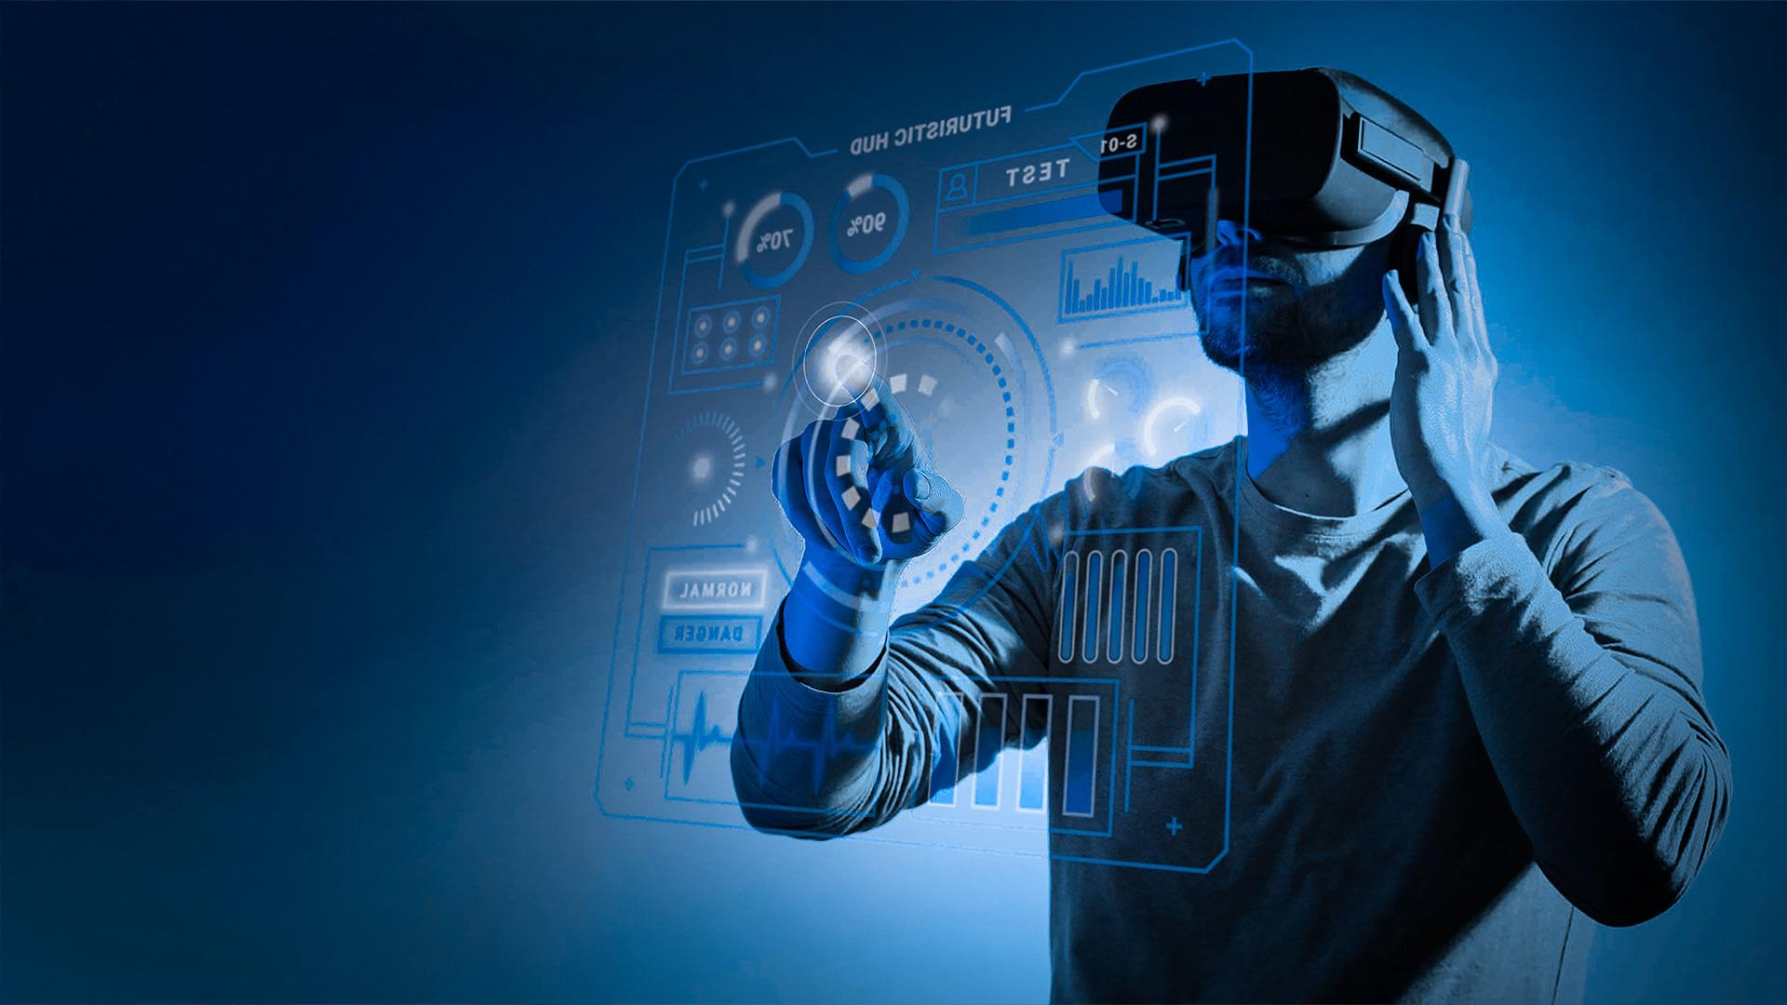
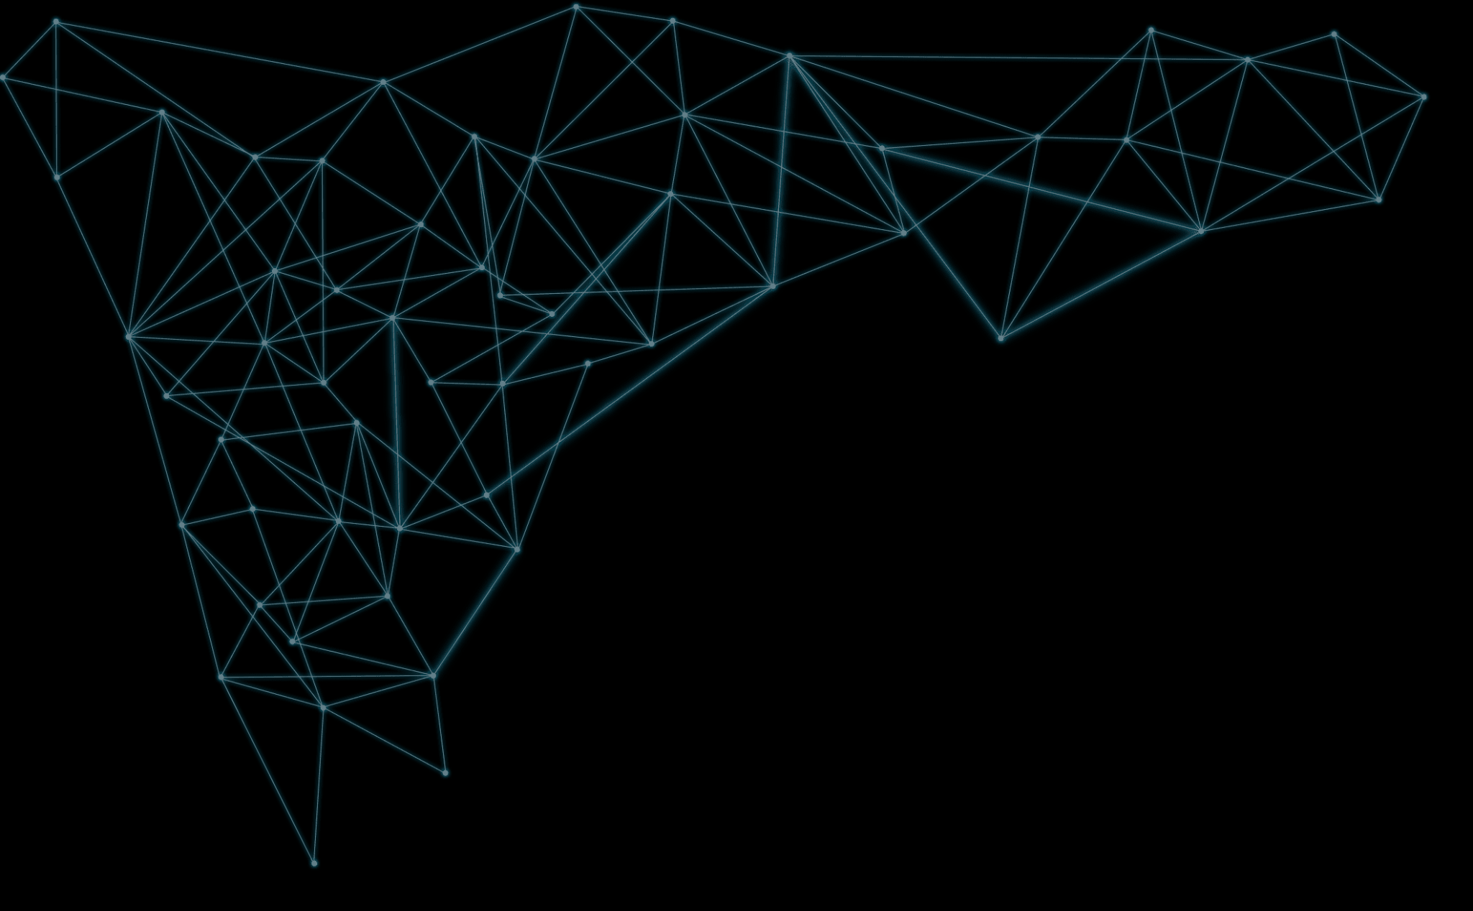
A picture is worth a thousand words

Slide 8
Study objectives
Venus
Mars
Venus is the second planet from the Sun
Despite being red, Mars is actually a cold place
Mercury
Saturn
Mercury is the closest planet to the Sun
Saturn is composed of hydrogen and helium

Slide 9
150,000
Big numbers catch your audience’s attention

Slide 10
Literature review
AUTHOR (YEAR). Title of the publication. Publisher
Mercury is the closest planet to the Sun and the smallest one in the Solar System
AUTHOR (YEAR). Title of the publication. Publisher
Mars is full of iron oxide dust, which gives the planet its reddish cast
AUTHOR (YEAR). Title of the publication. Publisher
Jupiter is a gas giant and the biggest planet in the Solar System
AUTHOR (YEAR). Title of the publication. Publisher
Venus has a beautiful name and is the second planet from the Sun

Slide 11
Theoretical framework
Theoretical framework
Key terms
Relevant theories
Mercury is small
Earth harbors life
Jupiter is quite big
Theory 1
Framework
Saturn is a gas giant and has rings
Venus has a beautiful name and is the second planet from the Sun. It’s terribly hot, even hotter than Mercury, and its atmosphere is extremely poisonous
Theory 2
Neptune is the fourth-largest planet

Slide 12
Percentages
75%
85%
53%
Neptune
Venus
Saturn
Neptune is far away from us
Venus has a beautiful name
Saturn is a gas giant and has rings

Slide 13
Schedule
Jan | Feb | Mar | Apr | May | Jun
Task | Description |  | Date |  | Status
Task 1 | Mars is actually a cold place |  | Jan 1 - Mar 15 |  | Completed
Task 2 | Earth is where we all live on |  | Feb 1 - Apr 30 |  | In progress
Task 3 | Venus has a beautiful name |  | May 15 - Jun 30 |  | Delayed
TASK 1
Neptune is an ice giant
TASK 2
Mercury is the smallest planet
TASK 3
Saturn is a gas giant

Slide 14
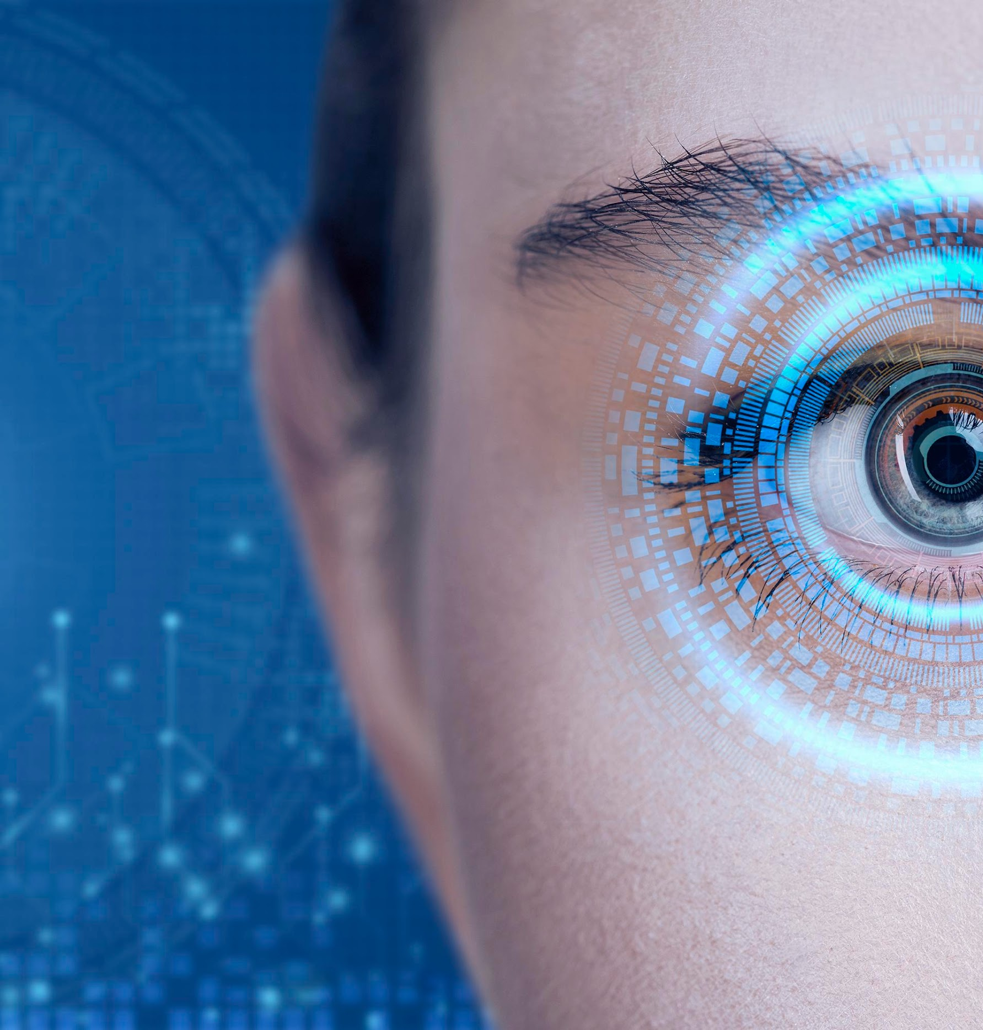
A picture always reinforces
the concept
Images reveal large amounts of data, so remember: use an image instead of a long text

Slide 15
Methodology
Type of data
Mercury is the closest planet to the Sun and the smallest one in the System
Motives
Venus has a beautiful name and is the second planet from the Sun
Mercury
Data collection
Despite being red, Mars is actually a cold place. It’s full of iron oxide dust
Specific sampling
Jupiter is a gas giant and the biggest planet in the Solar System

Slide 16
Locations
Mercury
Venus
Mars
Mercury is a small planet
Venus has a nice name
Mars is a very cold place

Slide 17
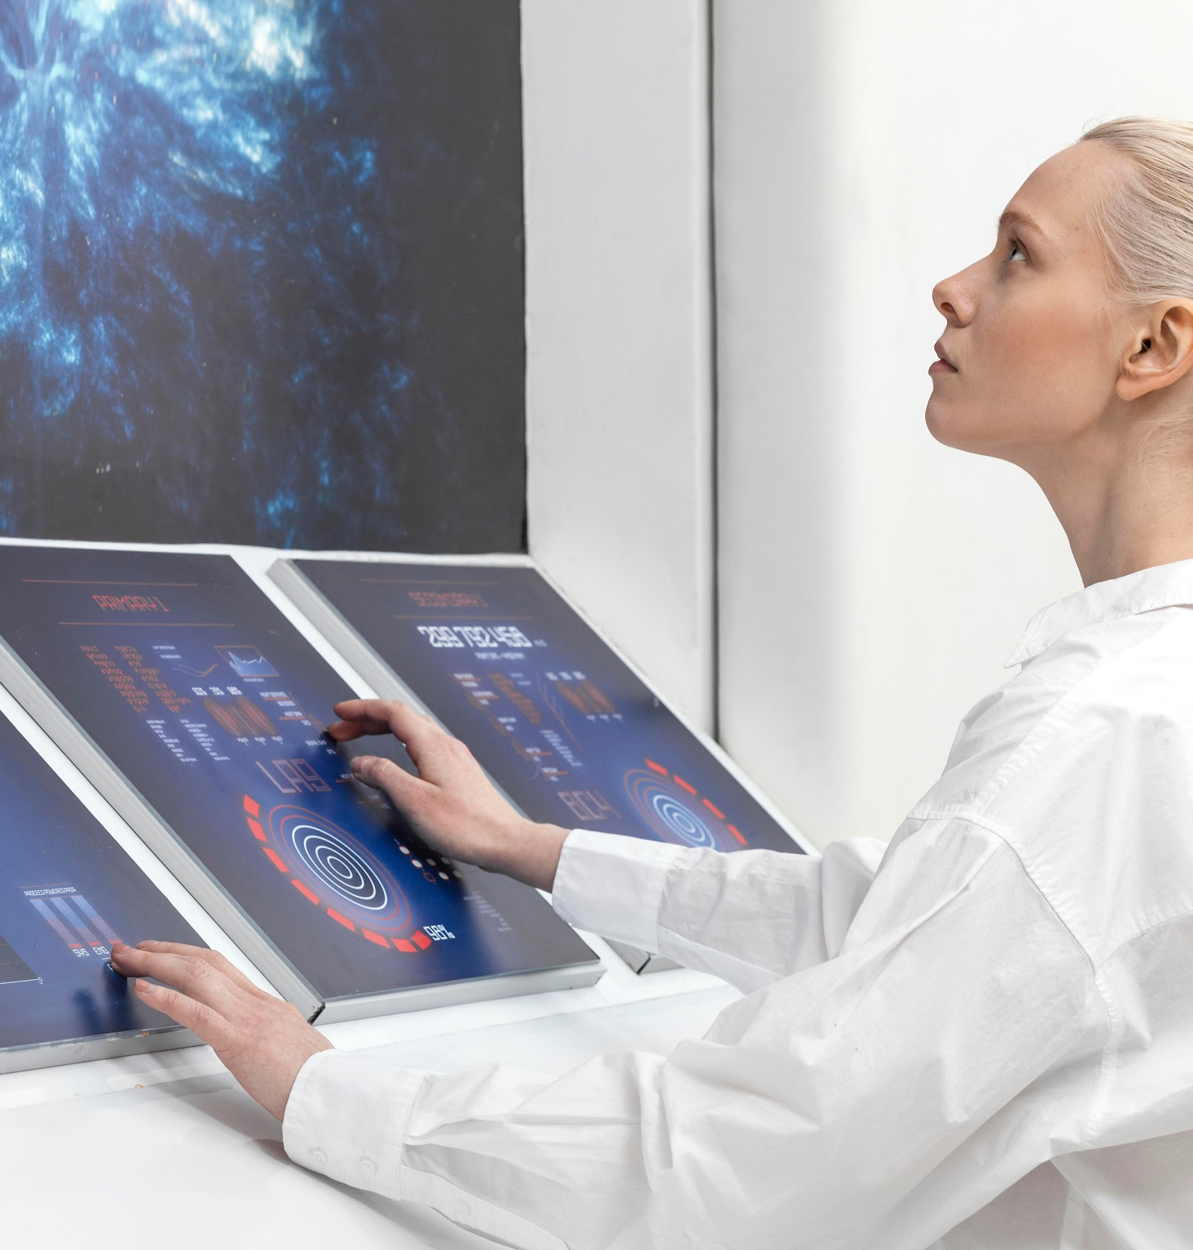

Analysis & development
Phase 1
Phase 2
Mercury is the closest planet to the Sun and the smallest one in the entire Solar System
Venus has a beautiful name and is the second planet from the Sun. It’s terribly hot!

Slide 18
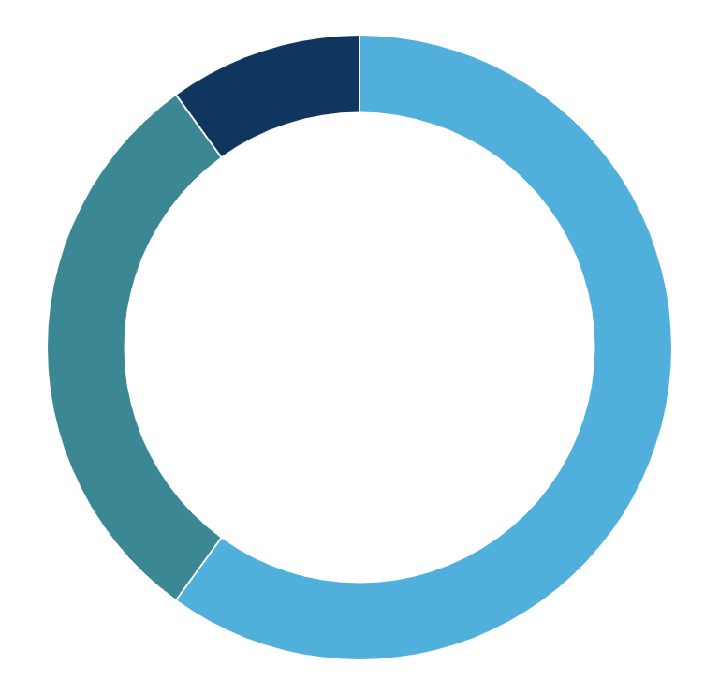
Analysis & development
Mercury
Mars
Venus
10%
Mercury is quite a small planet
30%
Mars is actually a very cold place
60%
Venus has a beautiful name
Follow the link in the graph to modify its data and then paste the new one here. For more info, click here

Slide 19
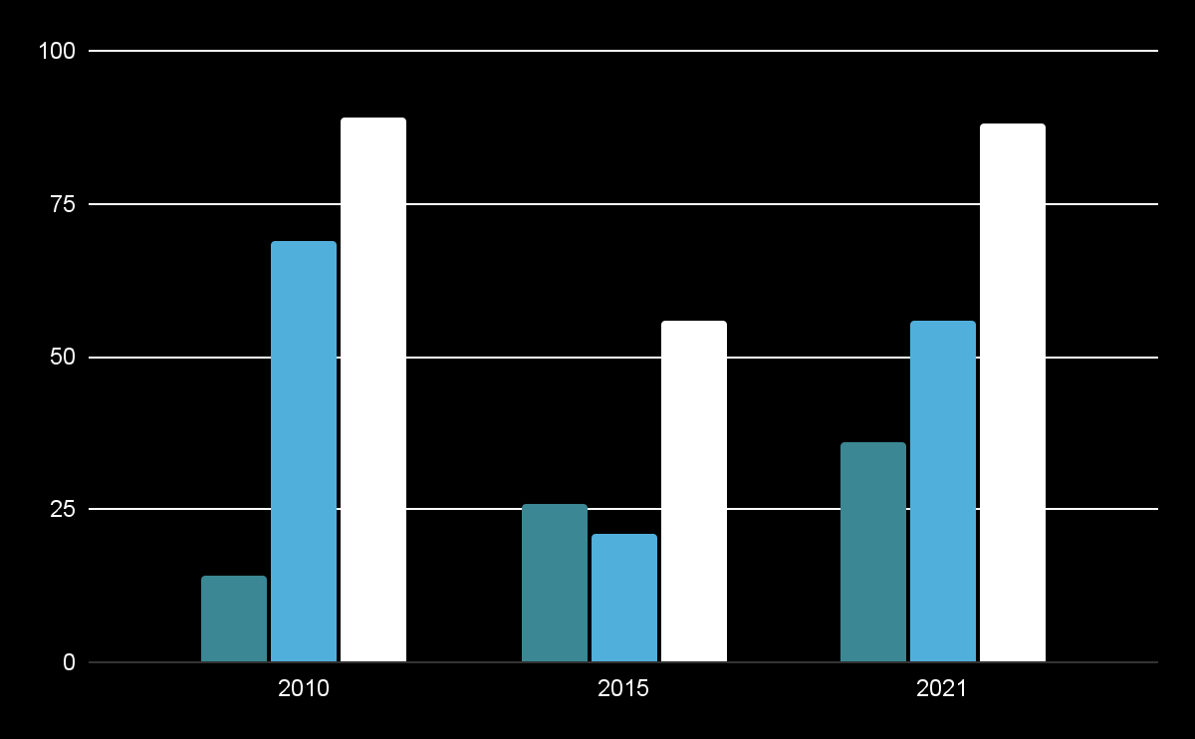
Analysis of the results
Mars
Despite being red, Mars is a cold place
Venus
Venus is the second planet from the Sun
Neptune
Neptune is the farthest planet from the Sun
Follow the link in the graph to modify its data and then paste the new one here. For more info, click here

Slide 20
Discussion
1
3
Discussion 1
Discussion 3
Mars is actually a very cold place
Saturn is a gas giant and has rings
Discussion 2
2
4
Discussion 4
Jupiter is the biggest planet of them all
Venus is the second planet from the Sun

Slide 21
Conclusions
Venus
Mercury
Mars
Jupiter
Saturn
Neptune
Venus is the second planet from the Sun
Mercury is the closest planet to the Sun
Despite being red, Mars is a cold place
Jupiter is the biggest planet of them all
Saturn is composed of hydrogen and helium
It’s the farthest planet from the Sun

Slide 22
Evolution
01
Mars
03
Venus
Mars is actually a very cold place
Venus is the second planet from the Sun
Jupiter
02
Saturn
04
Jupiter is the biggest planet of them all
It’s composed of hydrogen and helium

Slide 23
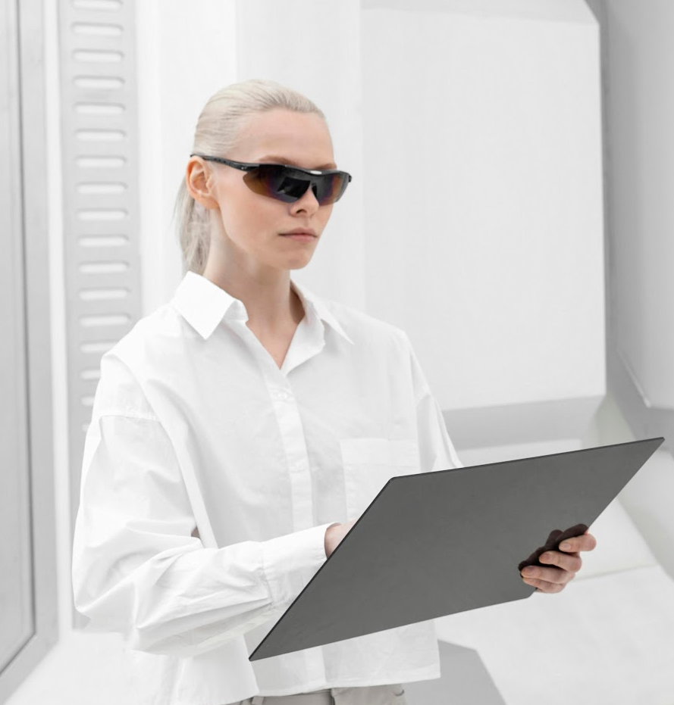
Technology references
Do you know what helps you make your point clear? Lists like this one:
They’re simple
You can organize your ideas clearly
You’ll never forget to buy milk!
And the most important thing: the audience won’t miss the point of your presentation at all. Let’s use lists!

Slide 24
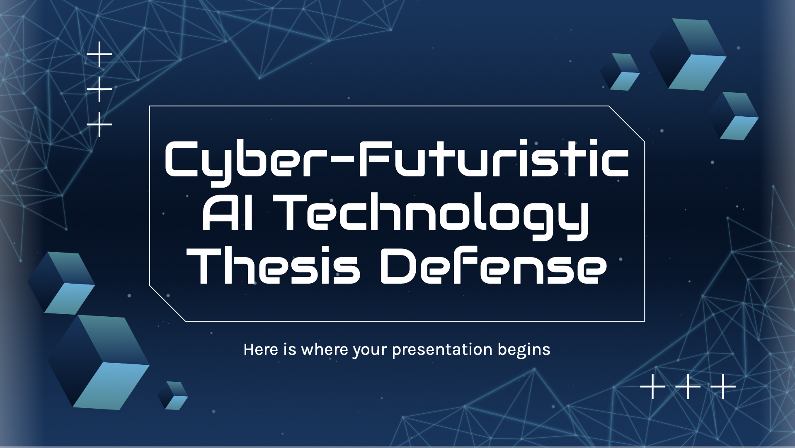
Mockup
You can replace the image on the screen with your own work. Just right-click on it and select “Replace image”

Slide 25
Thanks!
Do you have any questions?
youremail@freepik.com
+91 620 421 838
yourwebsite.com
Please keep this slide for attribution

